Slide 1

DEEP LEARNING based SEMANTIC SEGMENTATION for the detection of
SALT deposits from SEISMIC IMAGES
GUIDED BY Asst .prof R.D.D.V SIVA RAM
BATCH 13:
K GOPI -15VV1A0510
T KRISHNA SRAVANTHI -15VV1A0529
G SRINU -15VV1A0521
D SRAVANTHI - 15VV1A0503

Slide 2
CONTENTS
Problem statement
seismic Imaging
Computer vision
State of Art
System Flow
U-net Model Architecture
Implementation

Slide 3
PROPOsEd PROBLEM
Several areas of earth with large accumulation of oil and gas also have huge deposits of salt below the earth surface. But unfortunately , knowing where the large salt deposits are precisely very difficult.
One of the main challenge of seismic imaging is to identify the salt deposits present in the seismic image.
The above problem is specified and hosted in Kaggle Competition.

Slide 4
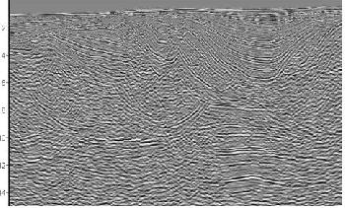
What is Seismic Imaging?
Seismic images are created by sending sound waves through the layers of the earth by using a sound source.
A microphone receives the reflected sound waves.
Seismic imaging uses sound waves to form three dimensional images of geologic formations.
These images are helpful in finding the deposits of oil , gas and salt concentration.

Slide 5

Computer Vision
Computer vision is concerned with the automatic extraction, analysis and understanding of useful information from a single image or a sequence of images.
It involves the development of a theoretical and algorithmic basis to achieve automatic visual understanding.
APPLICATIONS:-
1.Medical Image analysis
2.Image Restoration
3.Character Recognition , etc;

Slide 6
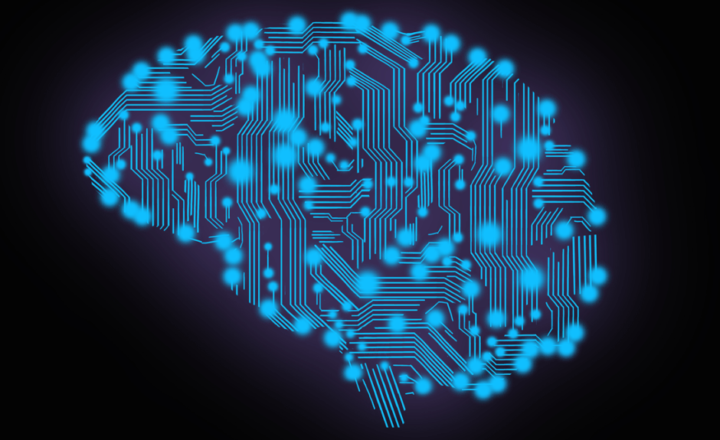
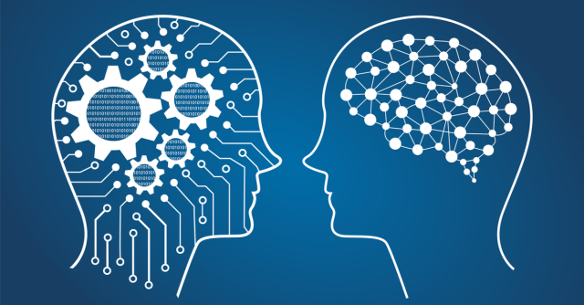
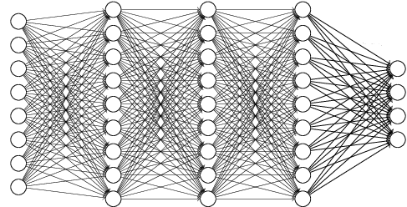
ARTIFICIAL INTELLIGENCE
Engineering of making intelligent machines and programs
MACHINE LEARNING
Ability to learn without being explicitly programmed
DEEP LEARNING
Learning based on deep Neural Network
1950’s
1960’s
1970’s
1980’s
1990’s
2006’s
2010’s
2012’s
2017’s

Slide 7
DEEP LEARNING
A machine learning subfield of learning representations of data. Exceptional effective at learning patterns.
Deep learning algorithms attempt to learn (multiple levels of) representation by using a hierarchy of multiple layers
If you provide the system tons of information, it begins to understand it and respond in useful ways.
WHY DEEP LEARNING?
Manually designed features are often over-specified, incomplete and take a long time to design and validate.
Learned Features are easy to adapt, fast to learn
Utilize large amounts of training data

Slide 8

DEEP LEARNING TYPES: (CONT..)
Convolutional Neural Network:
input features are taken in batch wise like a filter, which help the image to remember the images in parts and can compute the
operations.
These computations involve conversion of the image from RGB to Gray-scale.
APPLICATIONS:
signal processing
image classification techniques.

Slide 9
STATE OF THE ART for cnn classifiers
Different types of CNN architectures which are available
CNN | Num of layers | Developed by | year | Error rate
LeNet-5 | 7 | Yan LeCun et al | 1998
AlexNet | 8 | Geoffrey Hinton | 2012 | 15.3%
ZFNet | 8 | Mathew Zailer and Rob Fergus | 2013 | 14.8%
GoogleNet | 22 | google | 2014 | 6.67%
VGGNet | 19 | Simonyan, Zisserman | 2014 | 7.3%
ResNet | 152 | Kaiming he | 2015 | 3.6%

Slide 10
The Earlier approaches are unable to cater to the vast amount of variations in images. FCNN’s work by consecutively modelling small pieces of information and combining them deeper.
This include :-
1.Variations in image
2.Difference in illumination
3.Hidden parts of image
4.Background Clutter
Seismic images contains all this types of variations and to predict accurately we go with FCNN.

Slide 11
SYSTEM overview:
INPUT
OUTPUT
FCNN
Model
Seismic Images
Segmented seismic
images

Slide 12
System Flow
Data Preprocessing and Data Loading
All images are sized to 101*101.CSV files are created for image data. This CSV file is given as input.
Model Building
A CNN model is build in order to identify the salt region.
Training
The train data csv file is given as input to train the system and training accuracy is noted.
Test data is given as input and output is collected. Accuracy is calculated.
Testing

Slide 13
Data Loading:
Image data is converted into csv files and given as input to the model by
using PANDAS in PYTHON.
The csv file consists of 2 fields they are
1.Image name
2.Pixel values of an image
Training data set
Validation data set
Test data
seismic
……
mask
seismic
mask
……
seismic
……
train.csv
validation.csv
test.csv

Slide 14
U-NET MODEL
Used for image segmentation.
Invariant to image size.
Mostly for Bio-medical image segmentation
Symmetric model

Slide 15
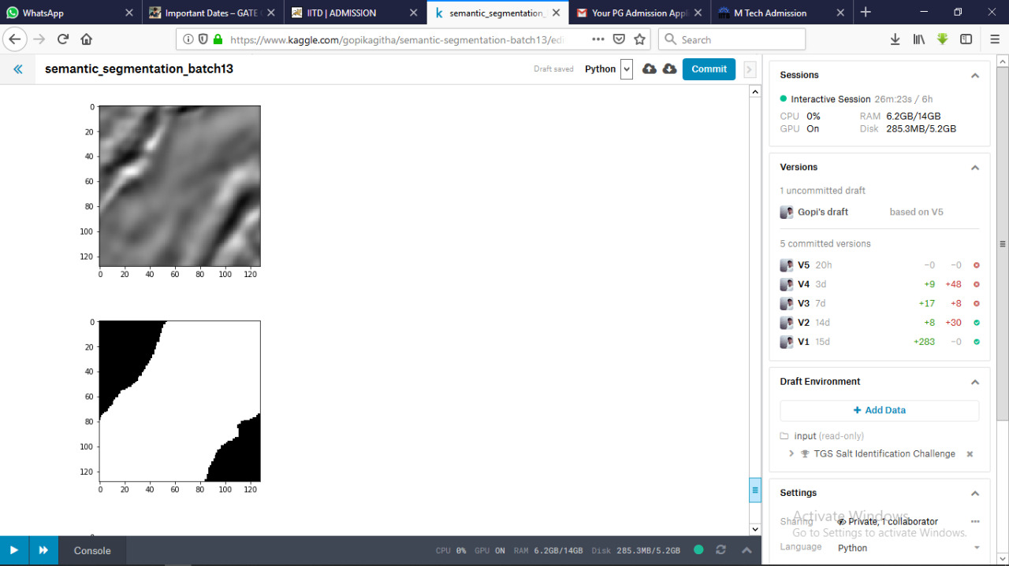
END-TO-END LEARNING
U-NET
Input image
Output segmentation map

Slide 16
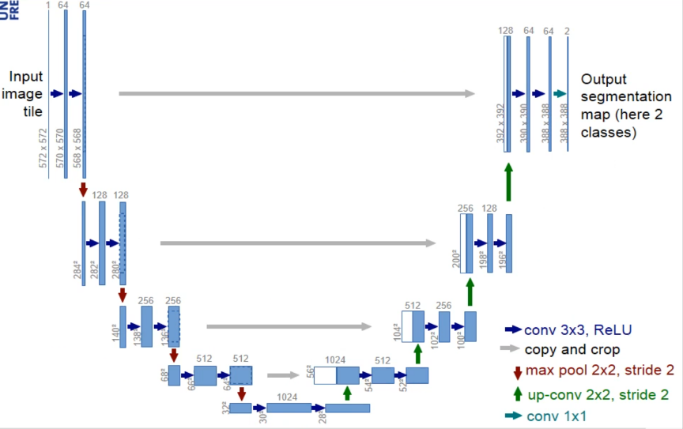
U-NET ARCHITECTURE

Slide 17
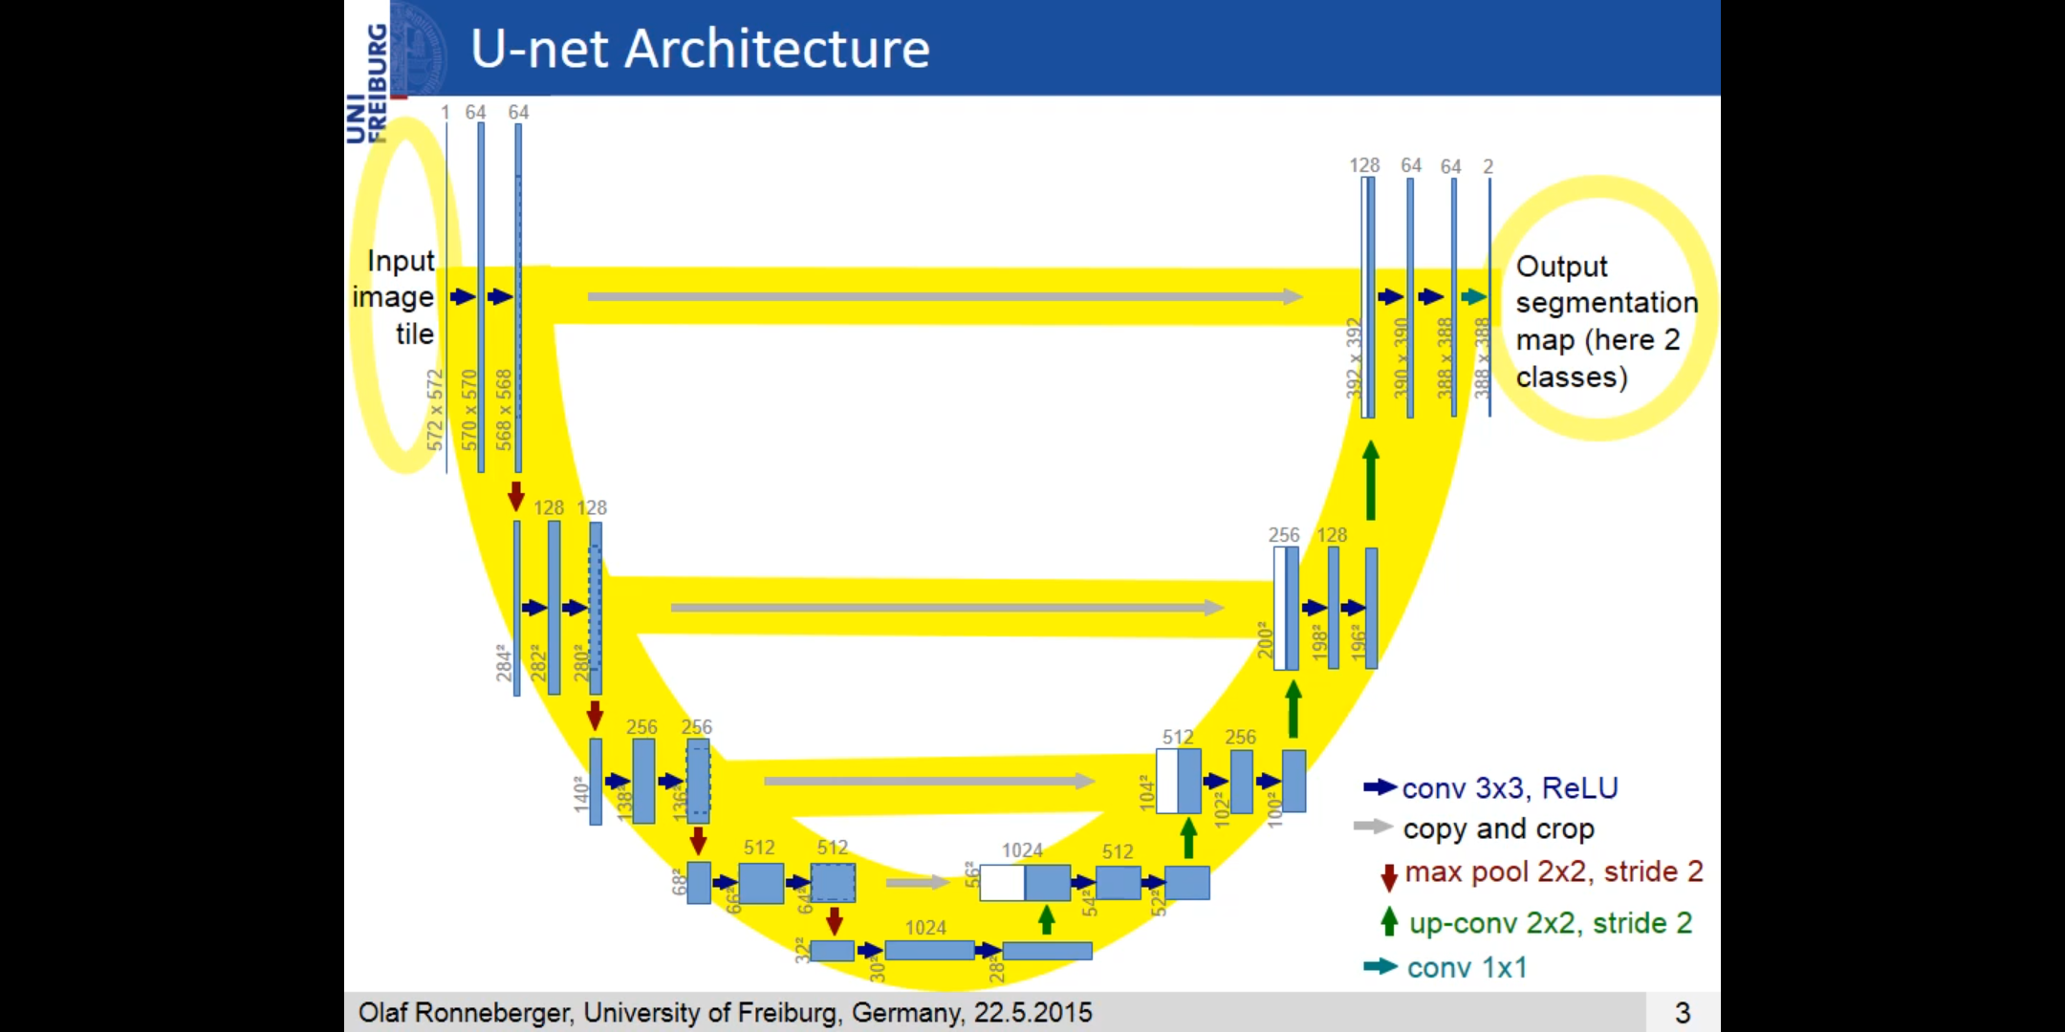
DATA PROPAGATION

Slide 18
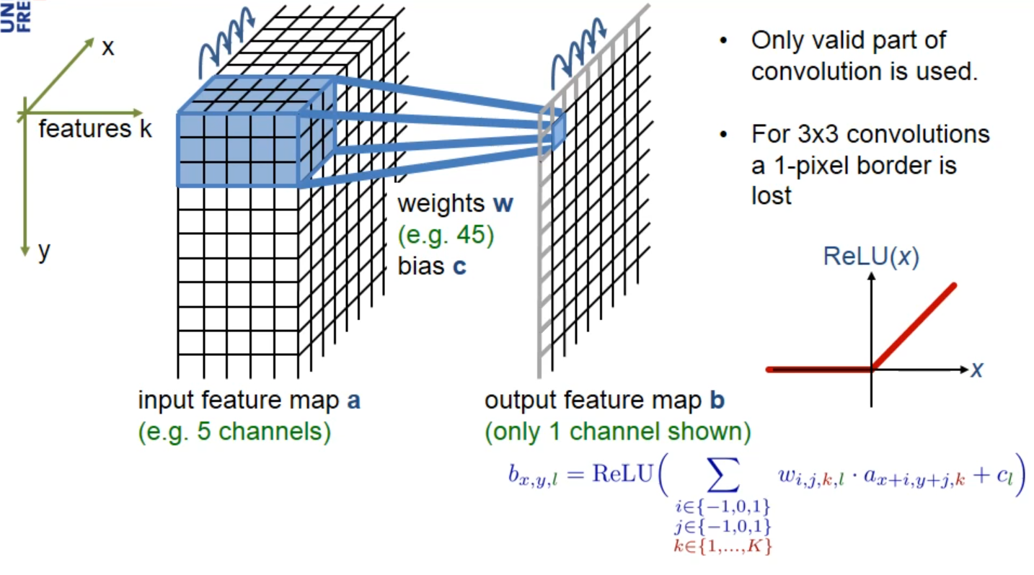
OPERATION – 3X3 CONVOLUTION + ReLU

Slide 19
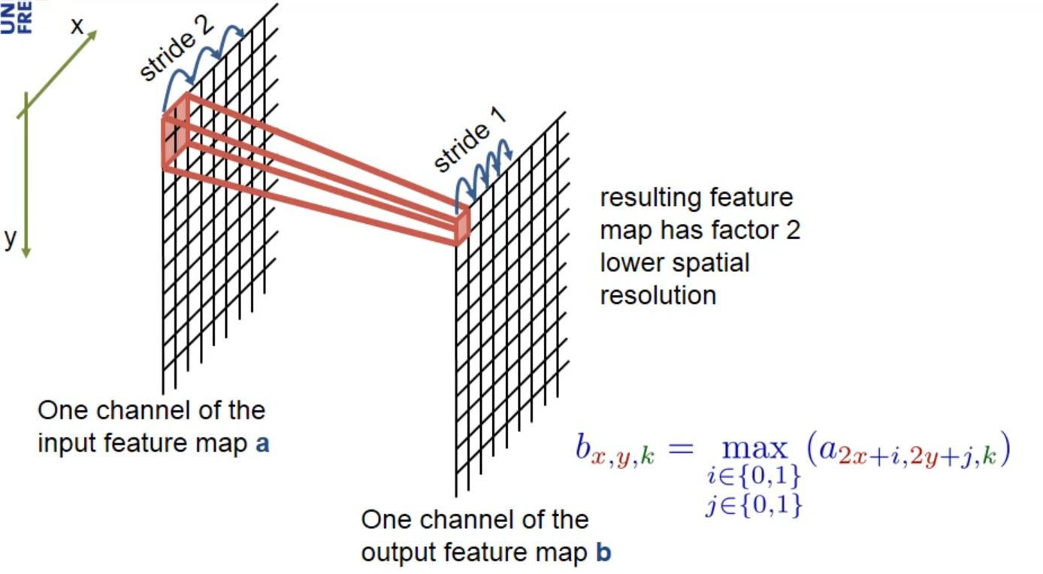
OPERATION - MAX-POOLING

Slide 20
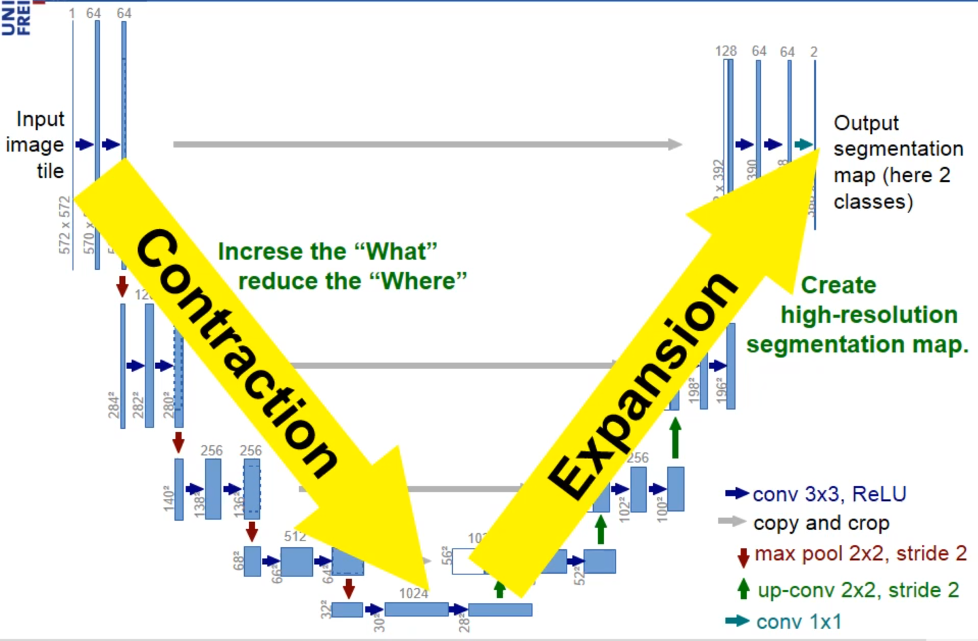
WHAT HAPPENS TO THE IMAGE???

Slide 21
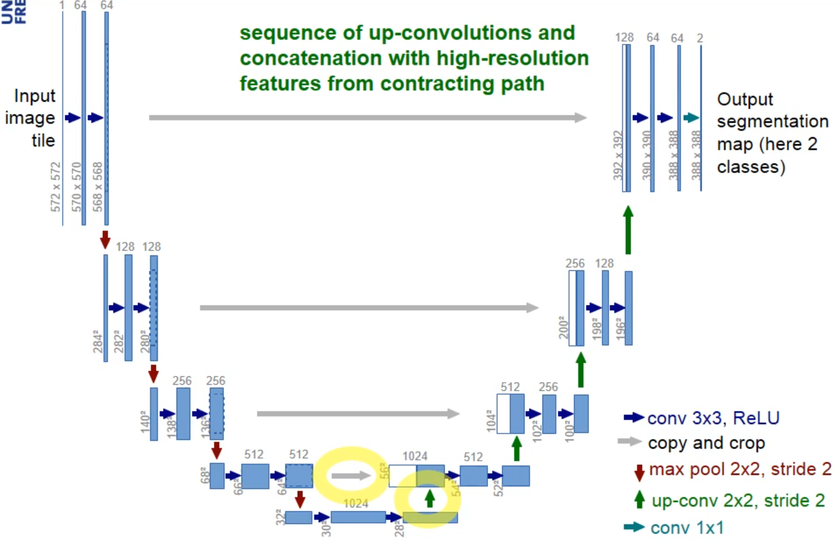
EXPANSION PATH

Slide 22
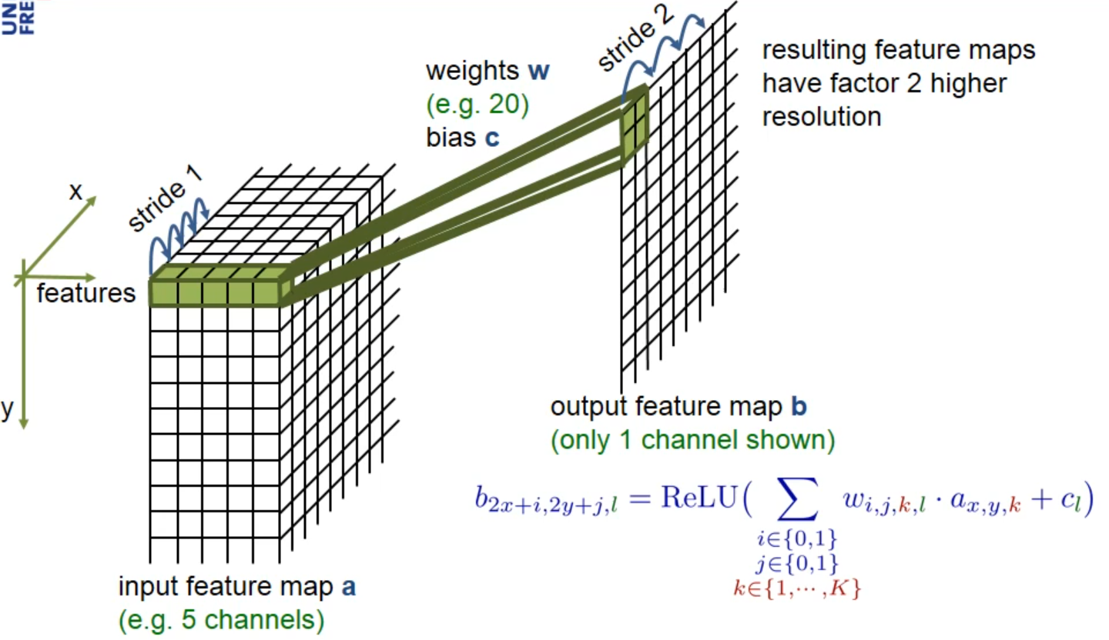
OPERATION – 2X2 UP-CONVOLUTION

Slide 23
CHALLENGES IN U-NET
Low number of training data – Augment using Deformations
Touching objects of same class
Resolution of an image data

Slide 24
Implementation:
1.kaggle kernel
2.preprocessing
3.data exploration
4.model building
5.training
6.plotting graphs
7.testing and predictions
8.Sanity check on some sample random images

Slide 25
1.kaggle kernel
kaggle platform offers computer vision problems which in turn provides free kernels for developing the model and training it. It offers free GPU support.
In parallel to this the data of the defined problem is already available in the created kernel input directory. Extra data set can also be added to the kernel.
The interactive session for a user is 9 hours.
2.preprosessing:
All the images in the date set are of size 101*101.To feed these input images to the U-Net model all the images are resized to 128*128.

Slide 26
Model building:
model used is U-net
activation function used is ‘relu’
optimizer used is ‘adam’
loss function used is ‘binary_cross_entrpy’
metrics used is ‘mean_iou’

Slide 27
Training
The system must to be trained with the defined model. The Weights or values of feature maps calculated from the given dataset during training phase are saved for future prediction.
CALLBACKS:
A callback is a set of functions to be applied at given stages of the training procedure. You can use callbacks to get a view on internal states and statistics of the model during training. The callbacks we used in our model is
1.Earlystopping: Early stopping is a technique for controlling overfitting in machine learning models, especially neural networks, by stopping training before the weights have converged.

Slide 28
2. ModelCheckpoint:
Save the model after every epoch if the loss is decreased from the previous epoch’s loss otherwise ignore it.
After train the model we got 0.72 training mean_iou and the weights of the model are saved in the ’ .h5’ file.
Why weights are saved in h5 file?
Json file can be easily understand by the user but loading of weights to the model takes more time. Where as h5 file are faster.

Slide 30
A graph is plotted by using the matplotlib functions to plot

Slide 32
Testing and Predictions:
In this phase the final weights of trained model are used to predict the segmentations of test images.

Slide 33
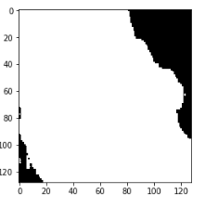
Output:
Output of the system is the machine predicted image i.e segmented seismic image.
Original image
Ground truth image
Machine predicted output

Slide 34

ANY QUERIES

Slide 35
THANK YOU FOR LISTENING
Presented by: BATCH 13

